Slide 1



AJIRIKA: Empowering Tanzanian Graduates
`Revolutionizes job readiness through real-world simulations. We address Tanzania's youth unemployment and skills gap, offering interactive tools for career success`
01

Slide 2

High unemployment rates and skills mismatch contribute to underemployment and decreased economic growth.
Youth Unemployment
Tanzania's youth unemployment rate is 13.5% (World Bank, 2023).
Skills Gap
70% of graduates lack practical skills required by employers, (Tanzania National Bureau of Statistics, 2023).
Industry Disconnect
65% of employers report a gap between academic training and job requirements, (Tanzania Employers' Association, 2023).
10

Slide 3


AJIRIKA Platform Solution
Job Simulations
Interactive scenarios for various industries, including IT, finance, project management etc.
Video Interviews
Mock interviews with real-time feedback to enhance communication skills.
Customisable Assessments
Role-specific evaluations to improve job readiness for different careers.
AI CV Review
AI-driven feedback and optimisation for CVs, with personalised recommendations.
06

Slide 4
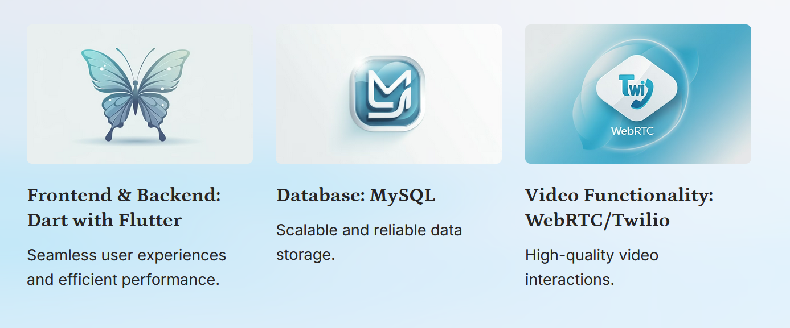
Product key features
04

Slide 5

Target Market
DETAILS | FACT | SOURCE
New graduates annually | approx 100000 | Tanzania Ministry of Education, 2023
Job seekers | 3 million+ | Tanzania National Bureau of Statistics, 2023
Mid-Career Professionals | about 48% skill shortage | World Bank & Mastercard newsroom
14

Slide 6
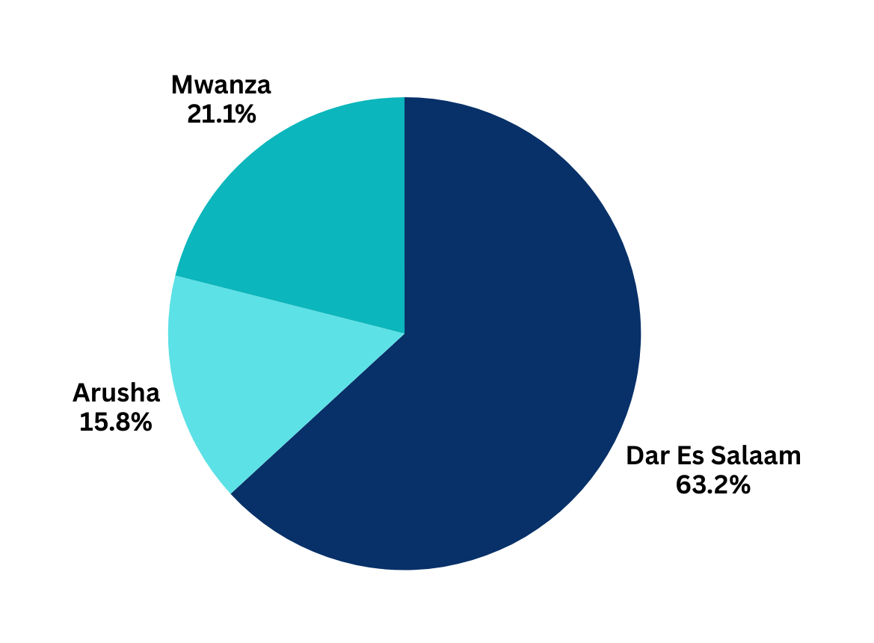
Market Size: Estimated 2M for the Pilot phase
Smartphone Penetration:
65% of Tanzanian youth aged 15-24 use smartphones.
Website Engagement:
Potential Estimate: Around 50-55% of smartphone users utilize websites for various activities, including social media, education, and information gathering.
Digital Literacy Rate:Overall literacy among Tanzanian youth aged 15-24 is approximately 87%, providing a strong foundation for tech engagement.
REFERENCES:
Groupe Spécial Mobile Association GSMA,
Tanzania Communication Regulatory Authority,
World Bank
Piechart01: Mobile users aged 15-24 as of 2023

Slide 7
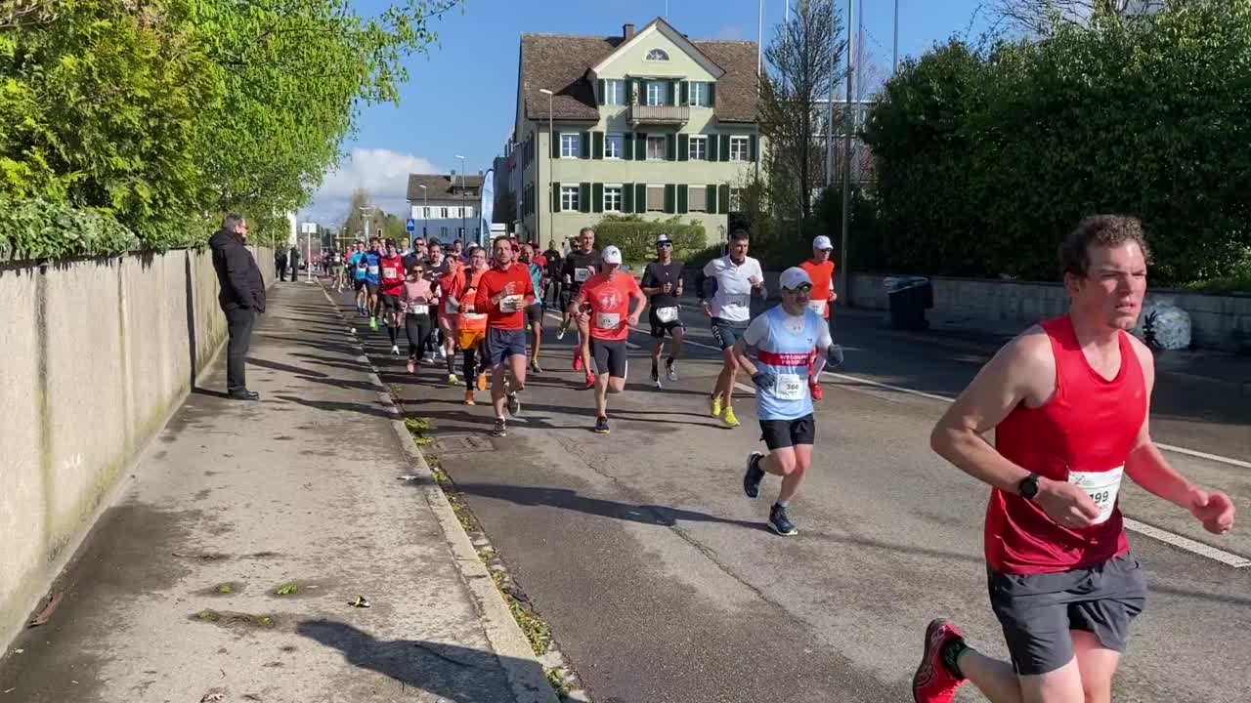



Competitors: TANZANIA
Zoom Tanzania, represents all other online platforms showcasing job openings.
Mzumbe University, representing Universities in Tanzania mainland
provide career guidance and skill development through their Career Service Units
Physical consultations
Zanzibar University, representing Universities in Zanzibar Island
provide career guidance and skill development through their Career Service Units
Physical consultations
23

Slide 8




Competitors: AFRICA
Online platform present in Nigeria, Kenya & Uganda
For Developers & Tech-related talent
Minimum requirement four(4) years technical experience
Online platform present in South Africa
For writers and writing professionals
Online platform present in Nigeria
For Developers & Tech-related talent
African Leadership University
Focus on leadership and entrepreneurship including internship & job placement.
Both physical consultations and online components
23

Slide 9

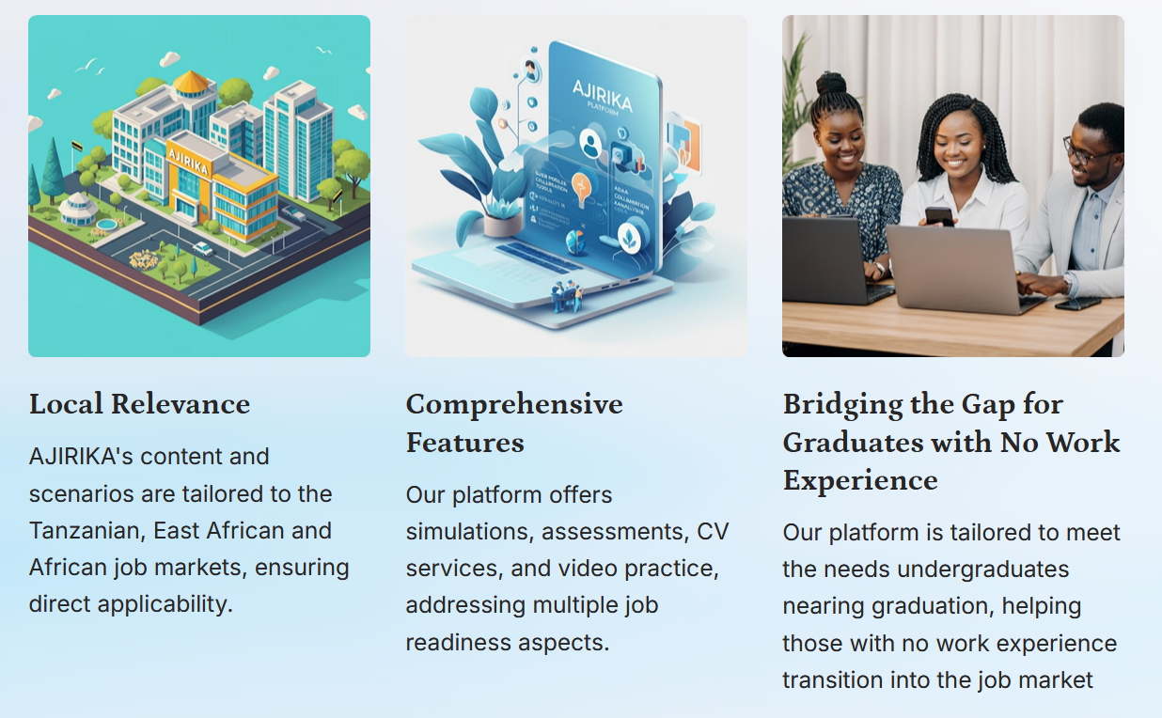
Competitive Advantage

Slide 10
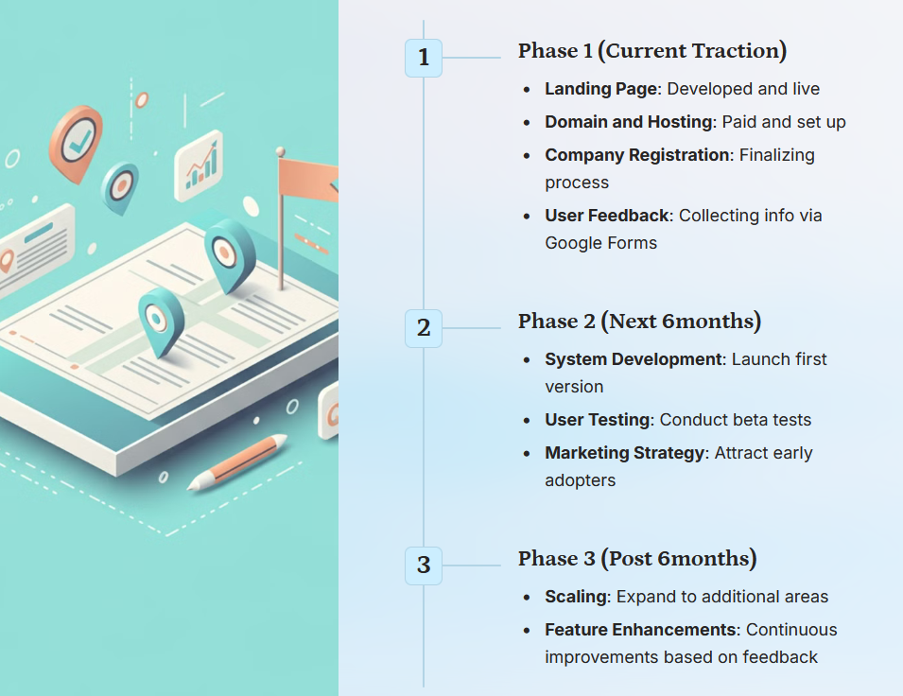
Project Traction
23

Slide 11
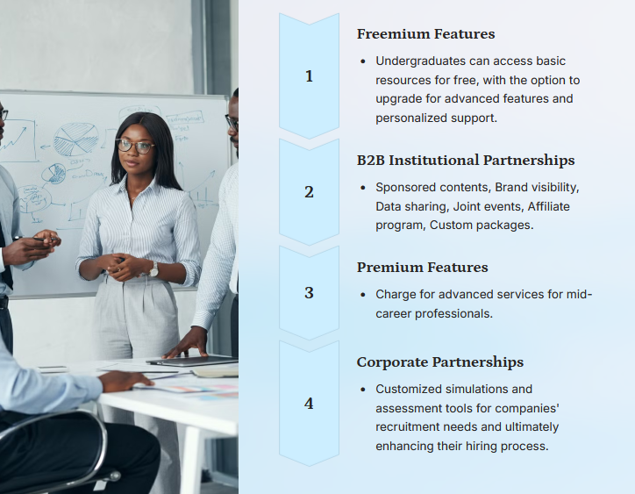
Business Model
23

Slide 12

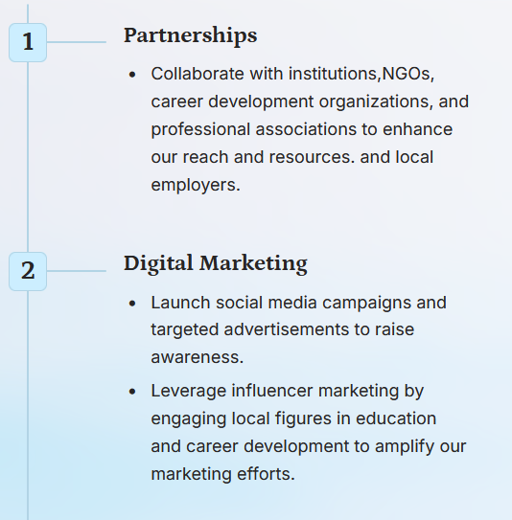
Go To Market

Slide 13
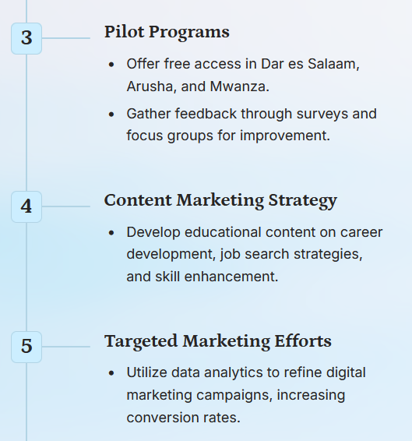
Go To Market

Slide 14



Social Impact

Slide 15
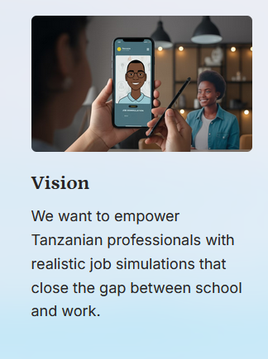
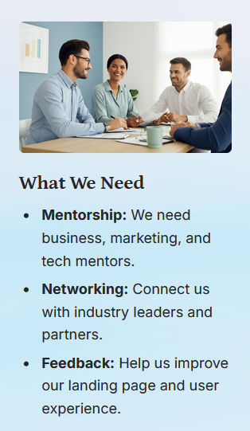
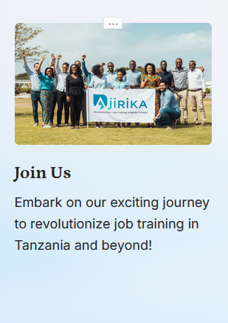
Our Ask

Slide 16

Team Members
KISIAKI JUMA
Founder

Slide 17




Thank you!
Email: Kisiaki.Juma@gmail.com
Mobile: 255 767241841
971 503440501
17

